Slide 1
Week 02 Intermediate HTML
Ace Acumen Academy
JINAL JADAV
19th January 2024

Slide 2
Intermediate HTML Tags
<div> and <span> tags
<div>: Stands for division, used as a container for grouping another HTML elements.
<span>: Used for applying style and scripting to a specific section.

Slide 3
Block level elements
Start on a new line.
Take up the full width available.
Example: <div>, <p>, <h1> to <h6>, <ul>, <li>

Slide 4
Inline Elements
Do not start on new line.
Take up only as much width as necessary.
Example: <span>, <a>

Slide 5
Grouping with <div>
Logical grouping of content for styling or layout purpose.
Example: <div class= 'container'>….</div>

Slide 6
Styling with <span>
Applying styling to specific portion of text.
Example: <p>This is <span style="color: green;">Green </span>Text.</p>

Slide 7
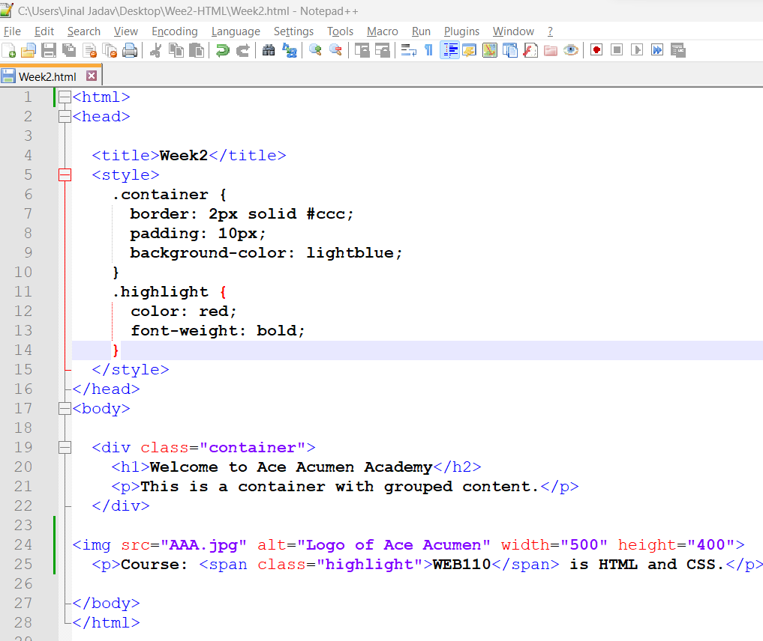
Example

Slide 8
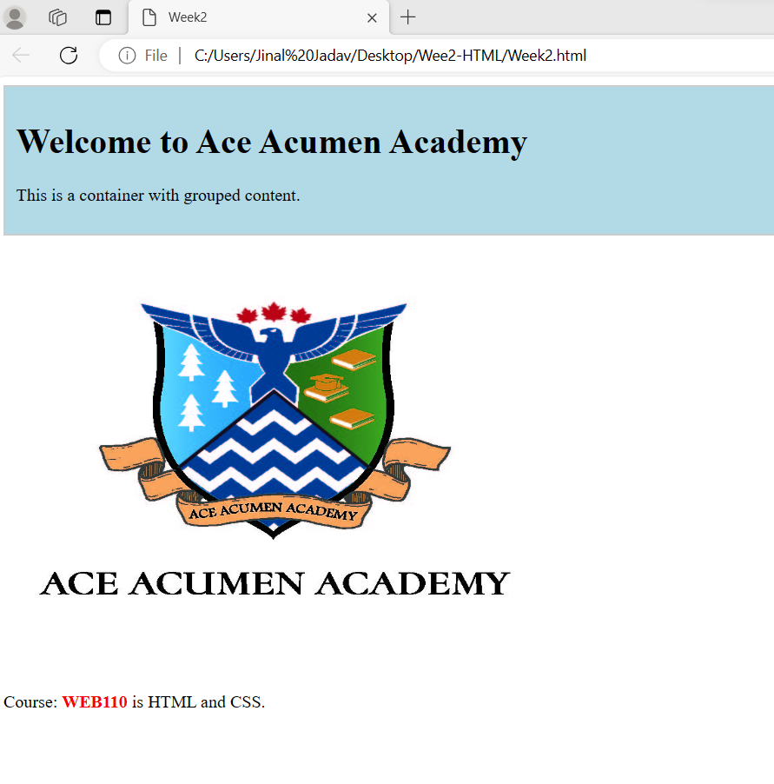
Output

Slide 9
Any Question??

